Slide 1

BDM Capstone Project Presentation
On
Enhancing Sales and Profit Maximization of Photocopy and Stationery Business
Presented by:
Manas Agarwal
21f1000670

Slide 2
Introduction
Business Information
Name: Balaji Photostat and Stationers
Established in 2001, Muzaffarnagar, Uttar Pradesh.
Focus: Photocopy and Sales of Stationery items (B2C).
Data analysis covers:
Sales and Purchase: August 2023– October 2023.
Project Objective
Identify challenges
Recommend solutions based on revenue & expenses analysis.
Analysis Tools
Spreadsheet functions
Charts

Slide 3
Problem Statement
Struggles with profitability amid market fluctuations and competitive pricing, impacting financial health.
Limited market awareness hampers Balaji Photostat growth despite quality products and services.
Background
Balaji Photostat, a profitable home business in Muzaffarnagar, UP, started in 2001 by Mr. Anuj Kumar Agarwal.
Despite offline operations and seasonal nature, it's self-financed, renowned for quality, and committed service.

Slide 4
Project Overview
Data Preprocessing
Analysis
Results
Data Collection
Interviews
Digitalization
Data Preprocessing
Cleaning
Labeling
Sales Analysis
Consumer Analysis
Expense Analysis
Profit Analysis
Interpretation of Data
Recommendations

Slide 5
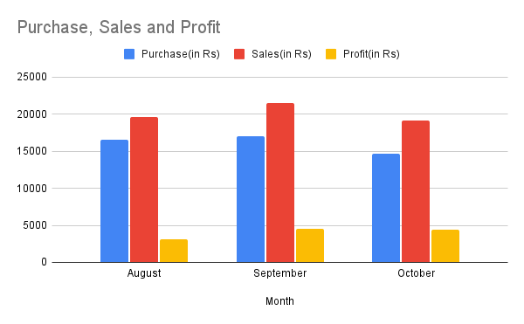
Result analysis
Balaji Photostat and Stationers Financial Journey: August 2023: Low profit of Rs. 3,060 due to low sales (19,660) despite investment (16,600). September 2023: Profit of Rs. 4,540 with increased revenue (21,540) and strategic purchases (17,000). October 2023: On track for continued success! Profit of Rs. 4,400 with revenue (19,100) and efficient investment (14,700).

Slide 6
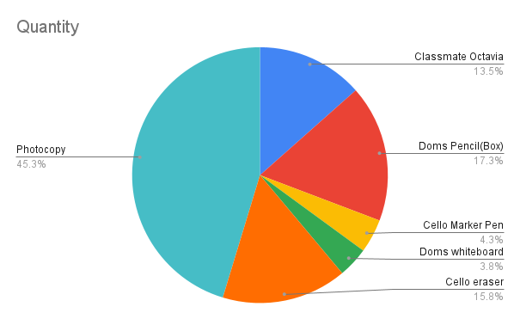
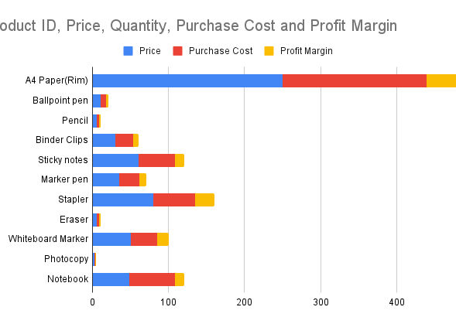
"Unlocking Market Success: Photocopies Dominate at 45.3%, Doms Pencils Follow at 17.3%, and Cello Erasers Secure 15.8% Share. Insights for Business Growth and Product Strategy."
"Supplier Sourced Insights: Analyzing Product Variety, Prices, Quantity, and Profit Margins for Informed Investment Decisions and Optimal Returns."

Slide 7
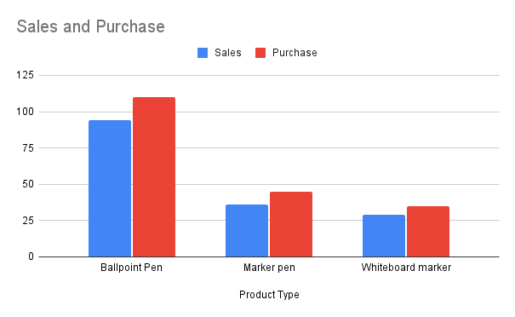
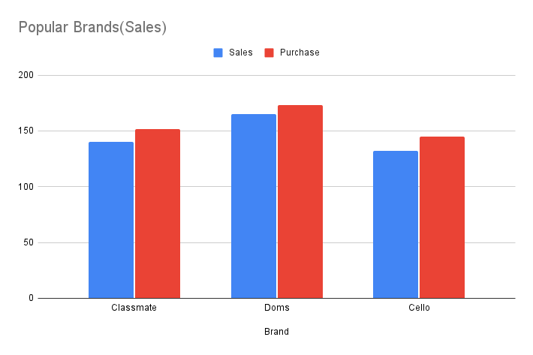
Demand Dynamics: Analysing product preferences and demand for informed business strategies.
"Charting Brand Demand: Navigating Market Trends for Strategic Investment and Planning in the Pen Market. Doms leading the market followed by Classmate"

Slide 8
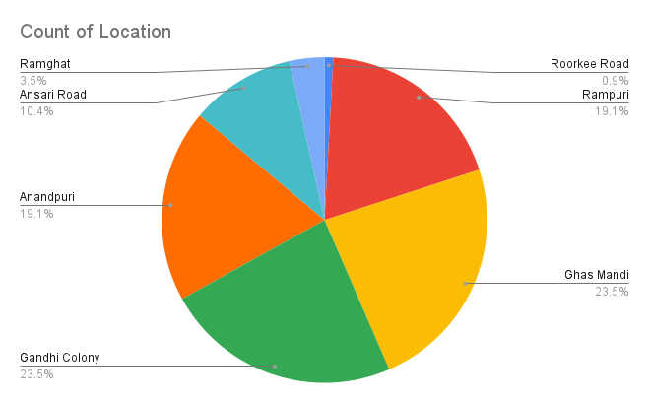
"Local Revenue Insights: Ghas Mandi & Gandhi Colony Lead, Highlighting Strong Local Roots. Areas like Roorkee Road, Ramghat, and Ansari Road require strategic marketing efforts to enhance customer awareness and increase footfall, ensuring broader market penetration and sustained growth."

Slide 9
Recommendations
Diversification: Expand product offerings to include complementary services such as printing services, office supplies, or digital solutions.
Enhanced Marketing: Invest in digital marketing strategies to reach a wider audience and improve brand visibility.
Customer Experience: Focus on improving customer service and enhancing the overall shopping experience to increase customer loyalty and retention.
Technology Integration: Embrace technology upgrades such as online ordering systems or digital payment options to streamline operations and improve efficiency.

Slide 10
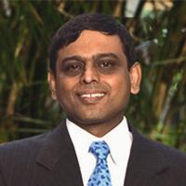

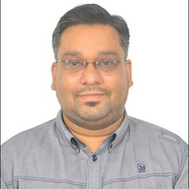
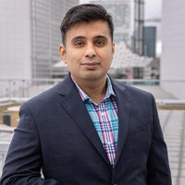
Thank you
Dr. G Venkatesh
Dr. Milind Gandhe
Dr. Aaditya Chandel
Dr. Ashwin J. Baliga
Professor of Practice, Department of Humanities and Social Sciences, IIT Madras
Chief Program Officer, Machine Intelligence and Robotics (MINRO) COE, IIIT Bangalore
Assistant Professor, IESEG School of Management
Research Scientist, IIT Madras

